Slide 1
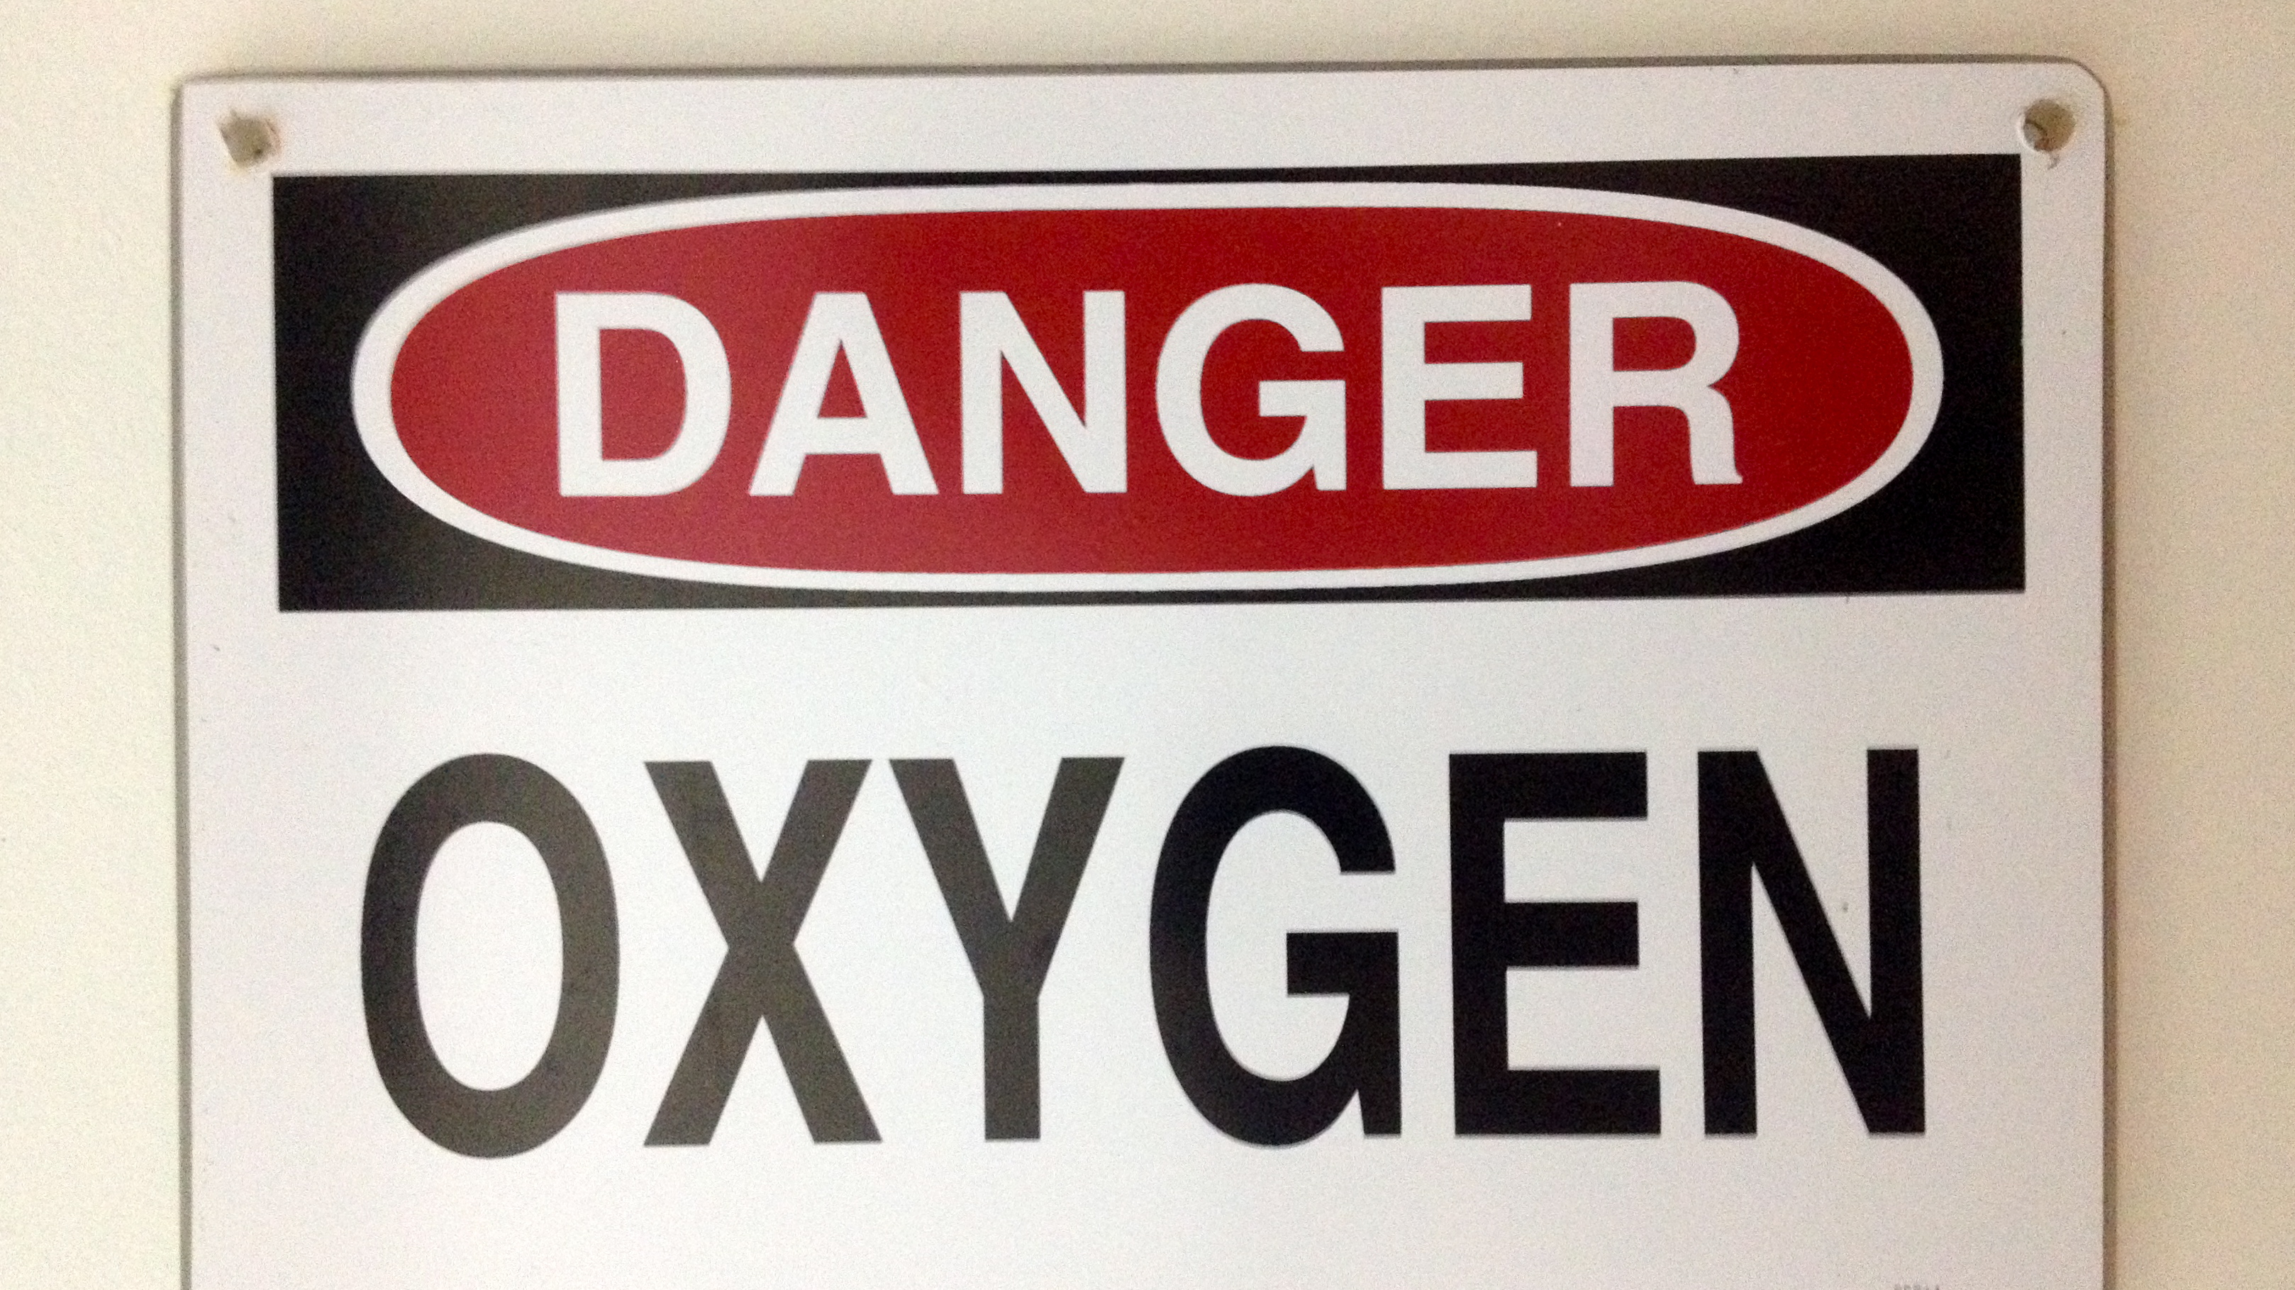

Hyperoxia – a load of hot air?
Chris Hebbes
Clinical lecturer and Senior Registrar in Anaesthesia and Critical Care medicine

Slide 2
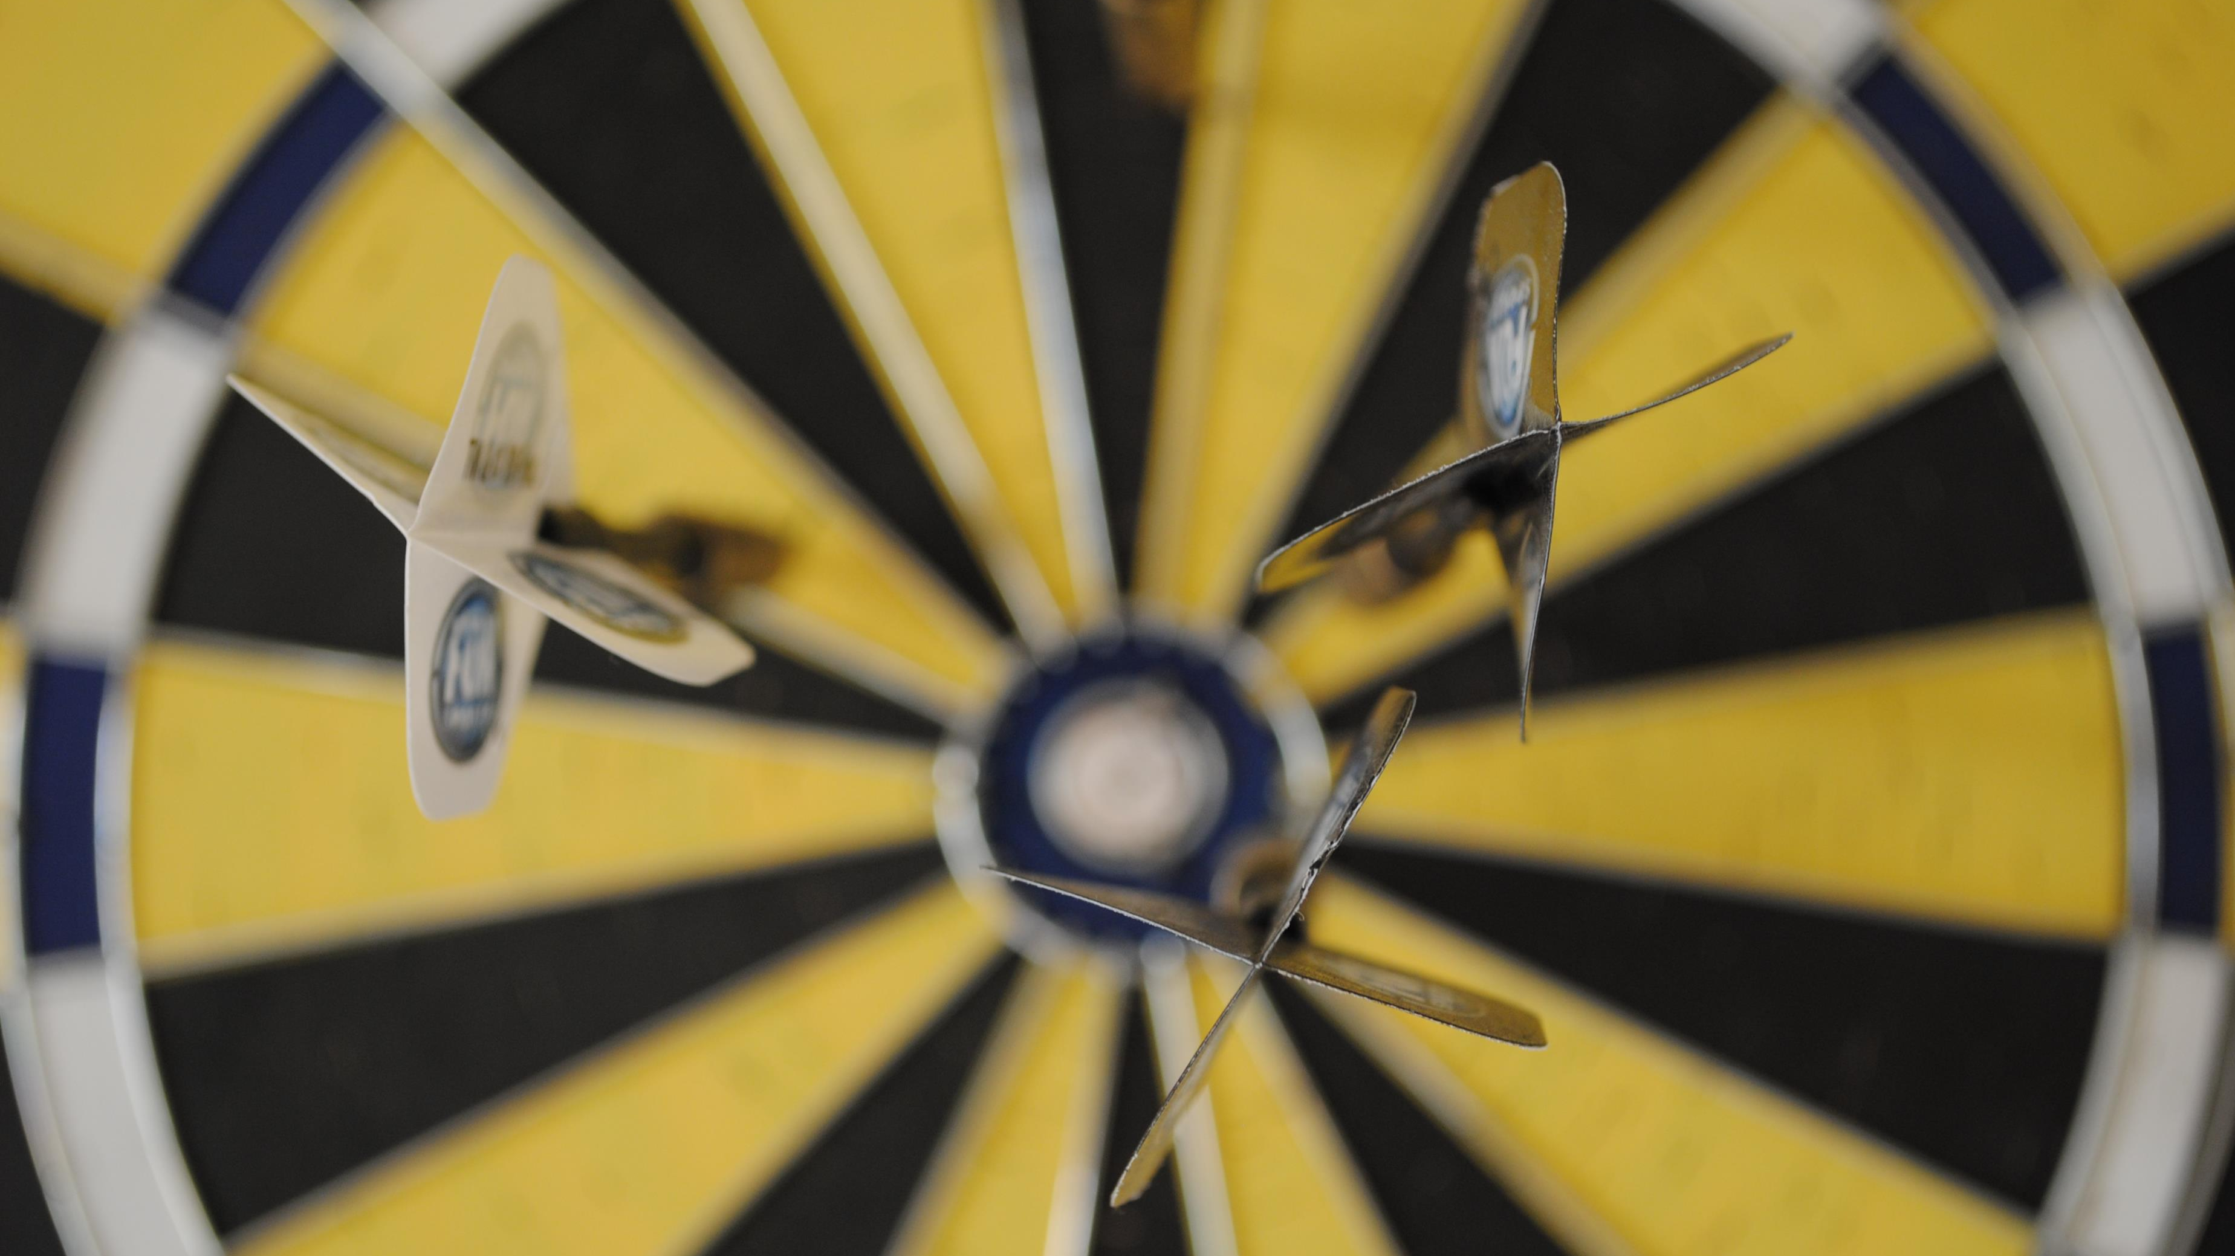
Aims
Definition – what it is
Problems associated with hyperoxia
Evidence
Incidence – how common in our practice
Notes:
Aims and objectives
Definition – what it is
Problems associated with hyperoxia
Incidence – how common in our practice
Evidence

Slide 3

Definitions
PaO₂ > 13.3 kPa
Probable/moderate hyperoxia PaO₂ 101-299 mmHg
Severe PaO₂ >300 mmHg
PaO₂ / FiO₂ ratio?
SpO₂ 97-100%
Notes:
Definitions vary
PaO2 >13.3 is pragmatic – only achievable with Oxygen
Artificial definitions of mod / severe

Slide 4
Hyperoxia with normal SpO₂
Hyperoxia with supraphysiological SpO₂
Notes:
If the SpO2 target used, distinction between SpO2>97% and patients on Oxygen with supraphysiological SpO2 / PaO2
T

Slide 5

Harms
Critical Illness
Oxygen
Reactive Oxygen Species
Inflammation
Multiorgan
dysfunction

Slide 6
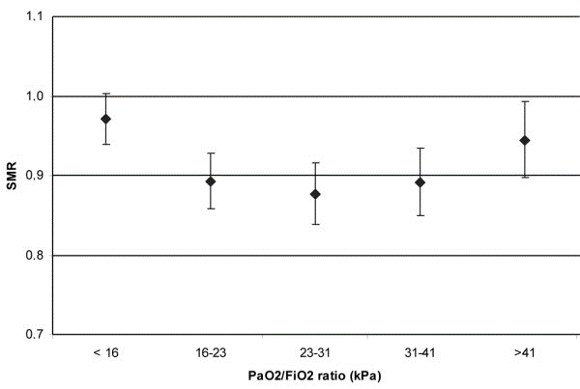
Oxygen may be harmful
SpO₂ 94-98%
SpO₂ >97%
(yes)
De Jorge 2008

Slide 7
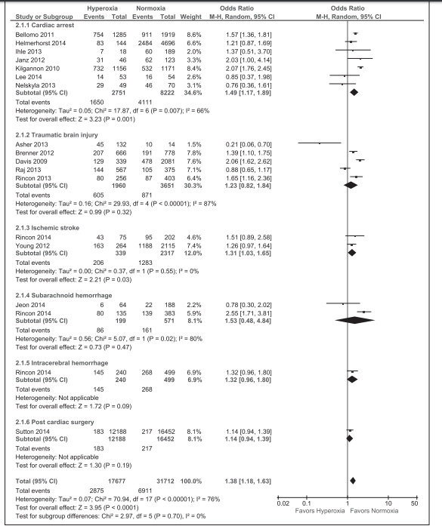
Oxygen may be harmful
SpO₂ 94-98%
SpO₂ >97%
(yes)
Helmerhorst 2015

Slide 8
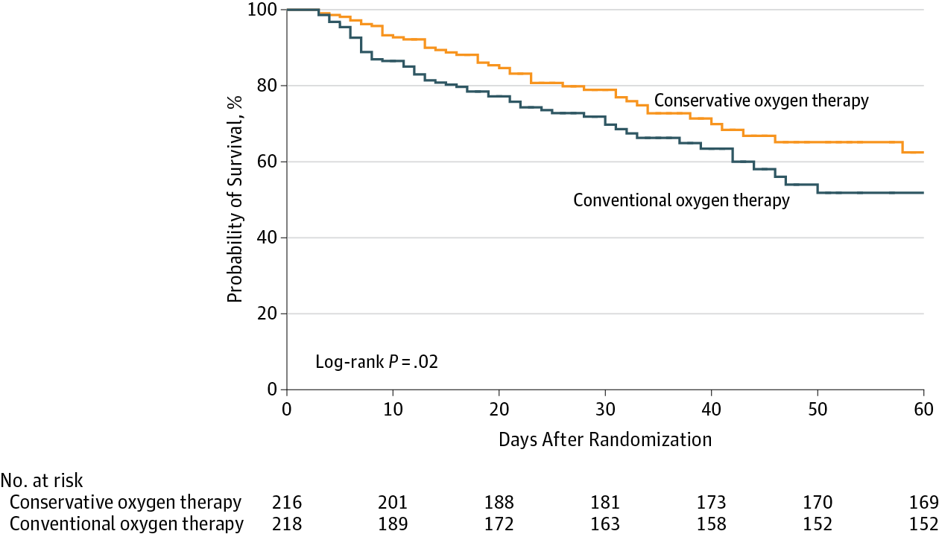
Oxygen may be harmful Does this apply to critical care?
SpO₂ 94-98%
SpO₂ >97%
(yes)
OXYGEN-ICU

Slide 9
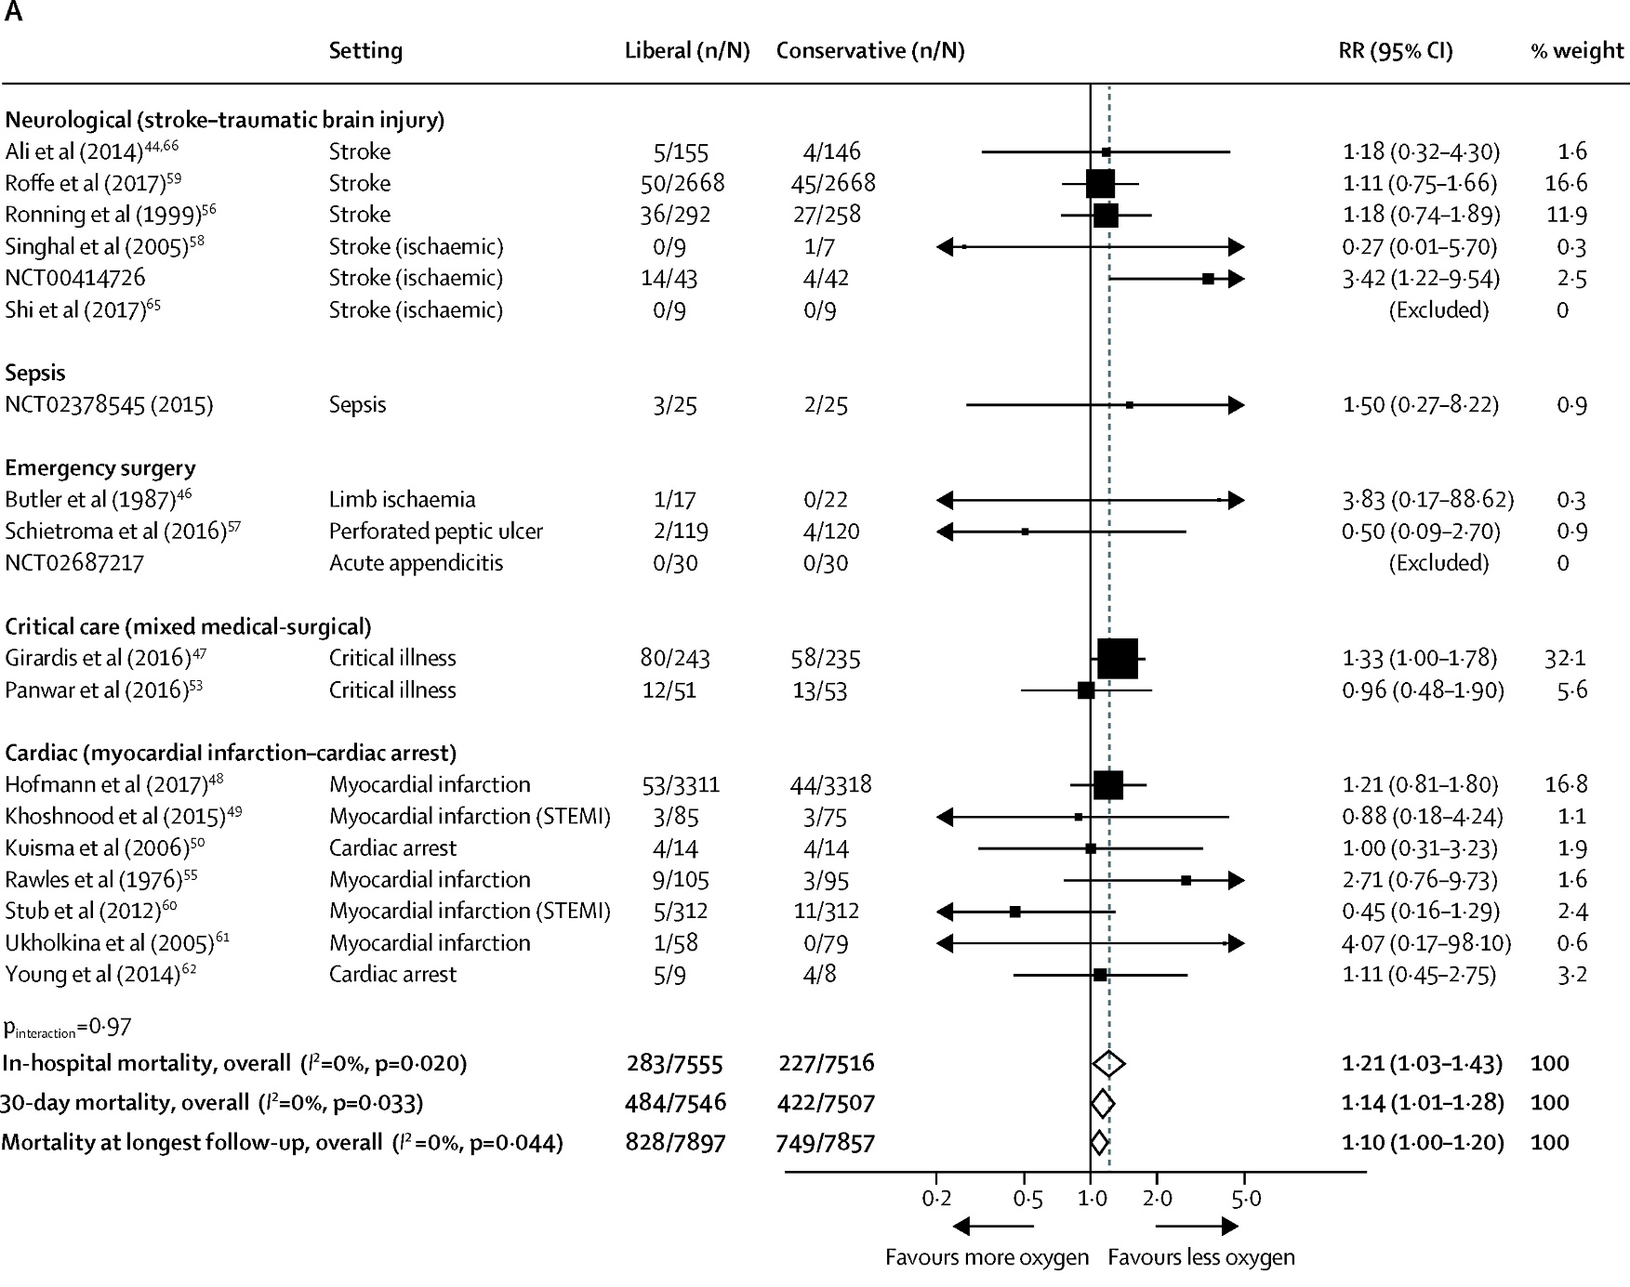
Is Oxygen harmful in different disease populations?
(maybe)
IOTA
Notes:
Definitions vary

Slide 10
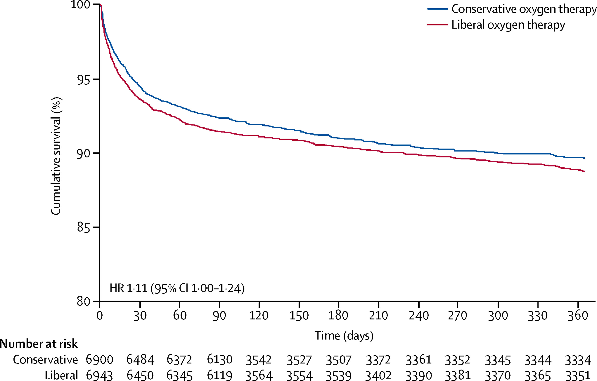
IOTA

Slide 11
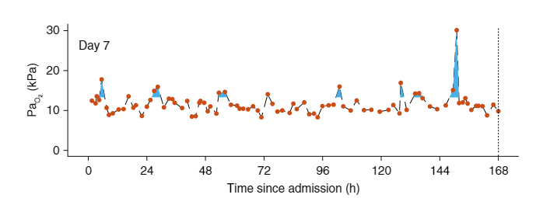
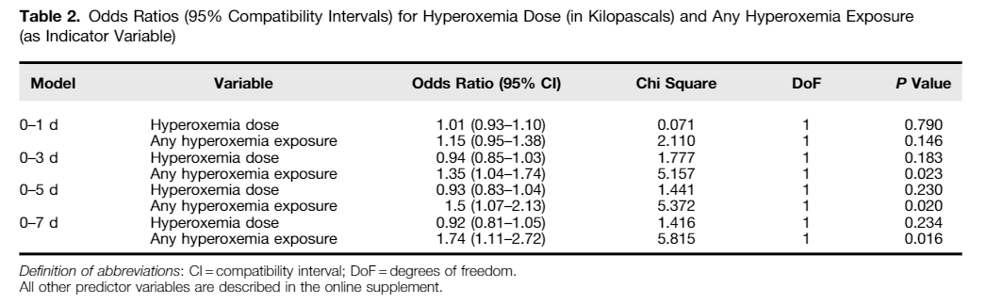
But how much Oxygen is harmful?
(very little)
The Association between Supraphysiologic Arterial Oxygen Levels and Mortality in Critically Ill Patients

Slide 12
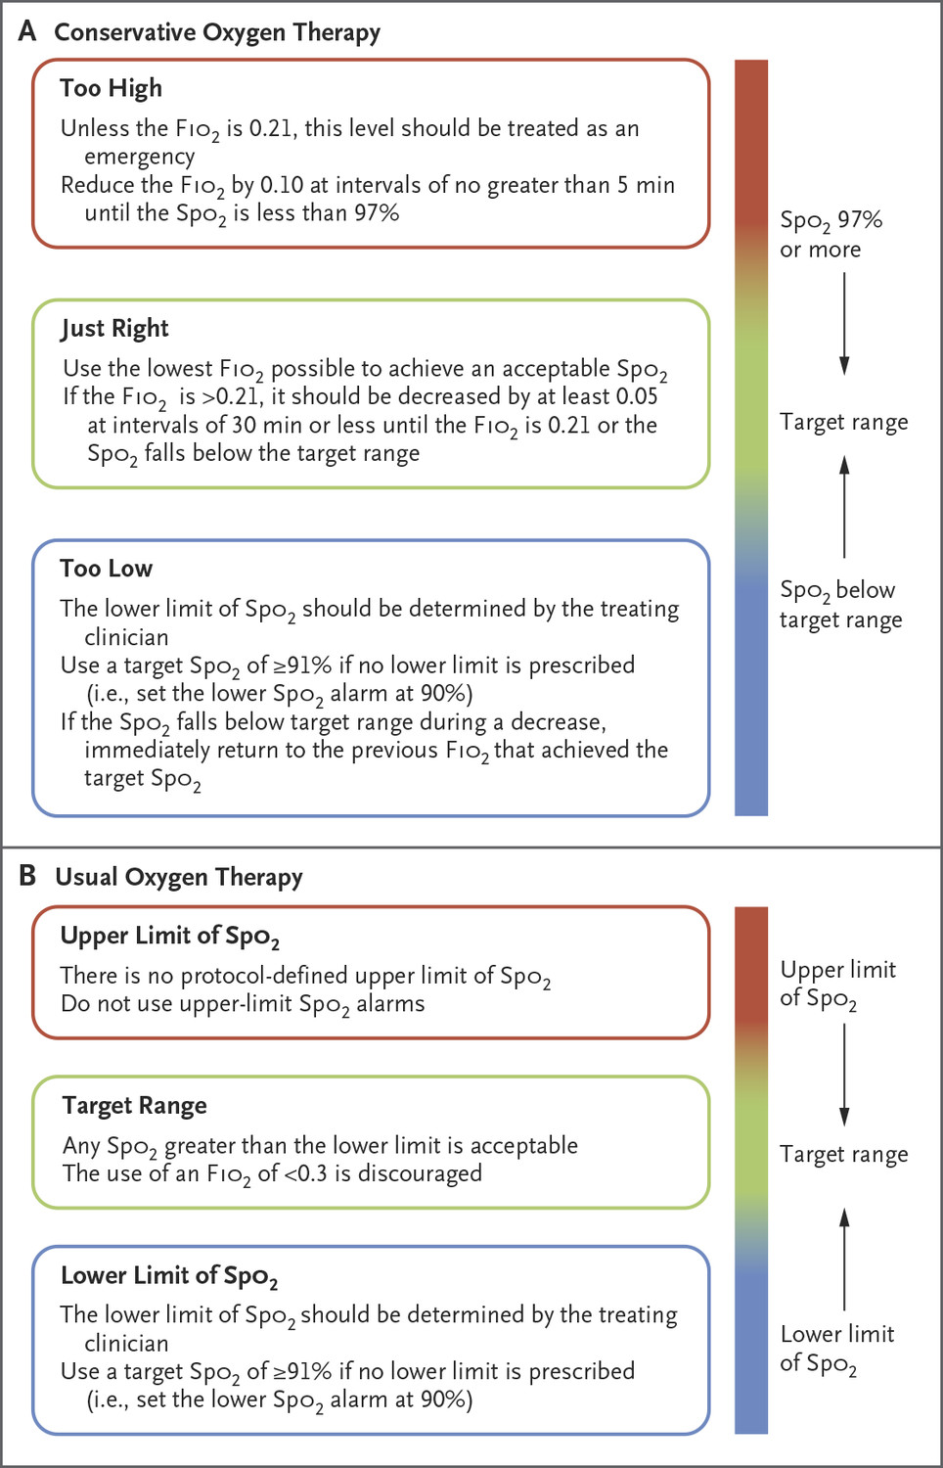
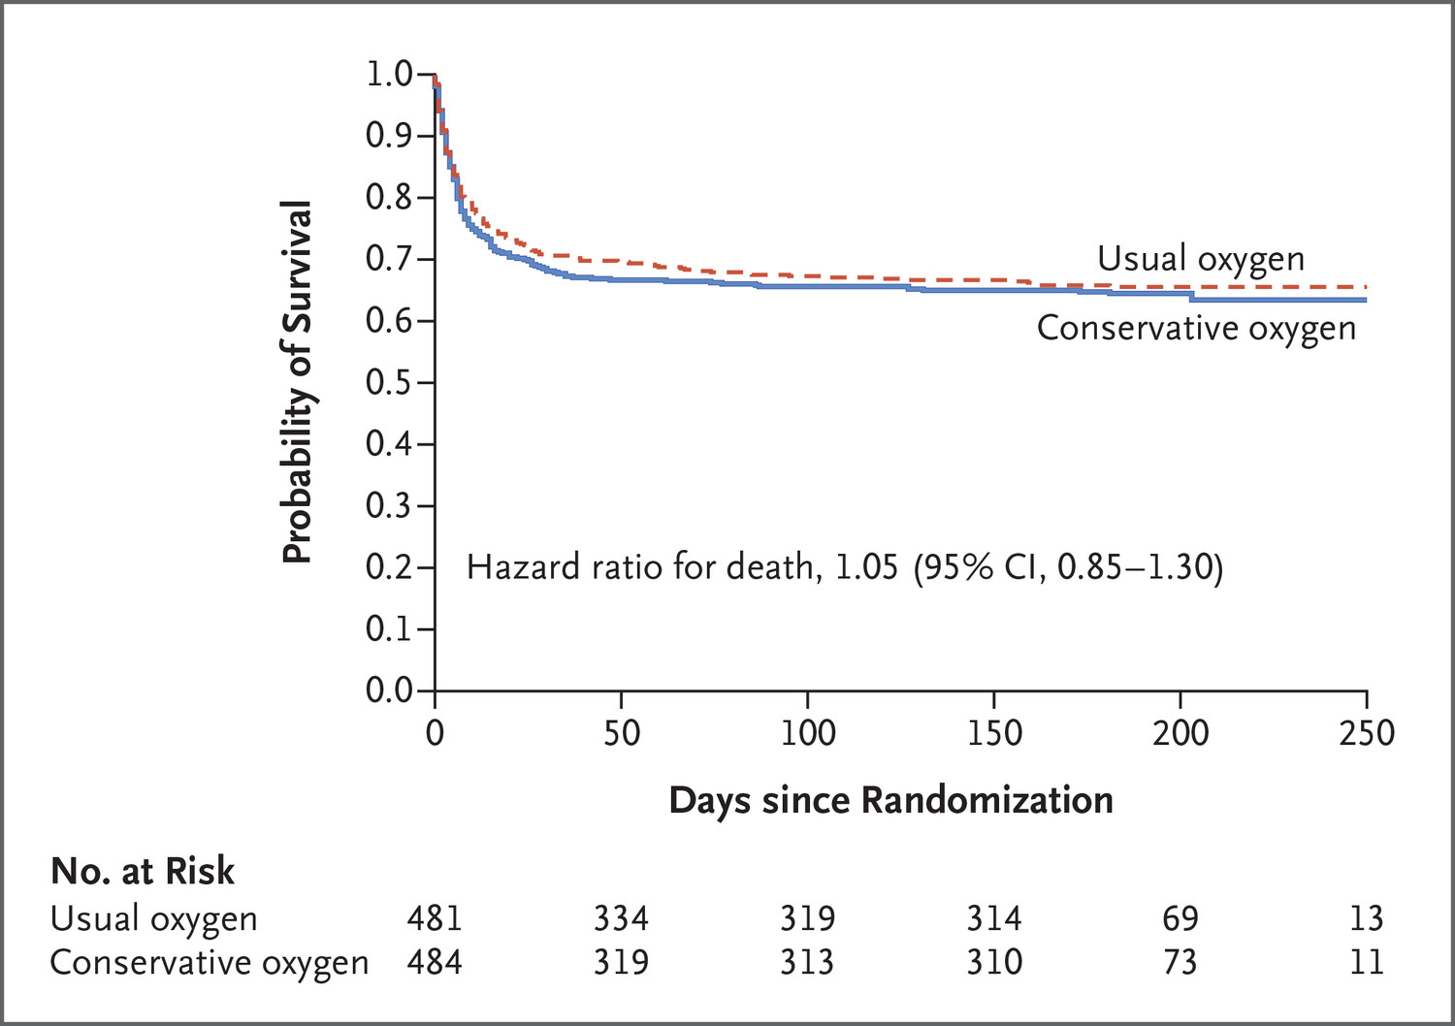
Possible solutions?
(ALARA?)
ICU-ROX

Slide 13
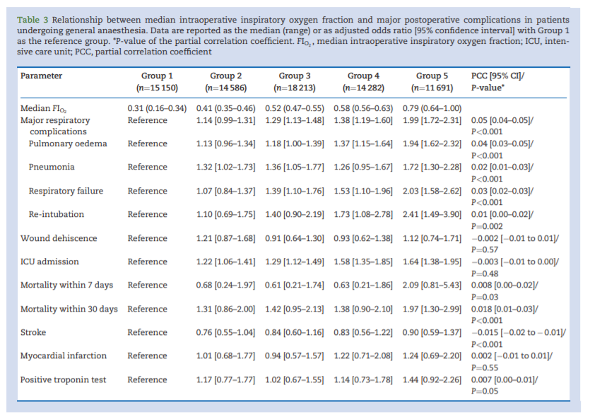
But surely my short anaesthetic won’t make a difference?
(yes, it does)
High intraoperative inspiratory oxygen fraction and risk of major respiratory complications

Slide 14
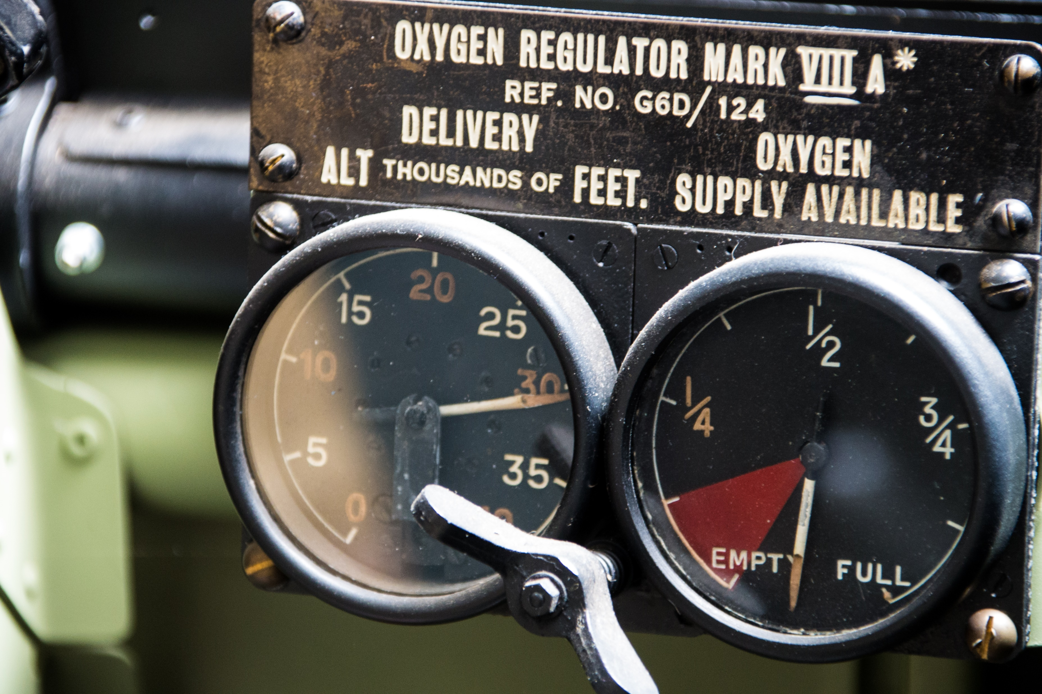
Incidence
Locally – hyperoxia is common on intensive care

Slide 15
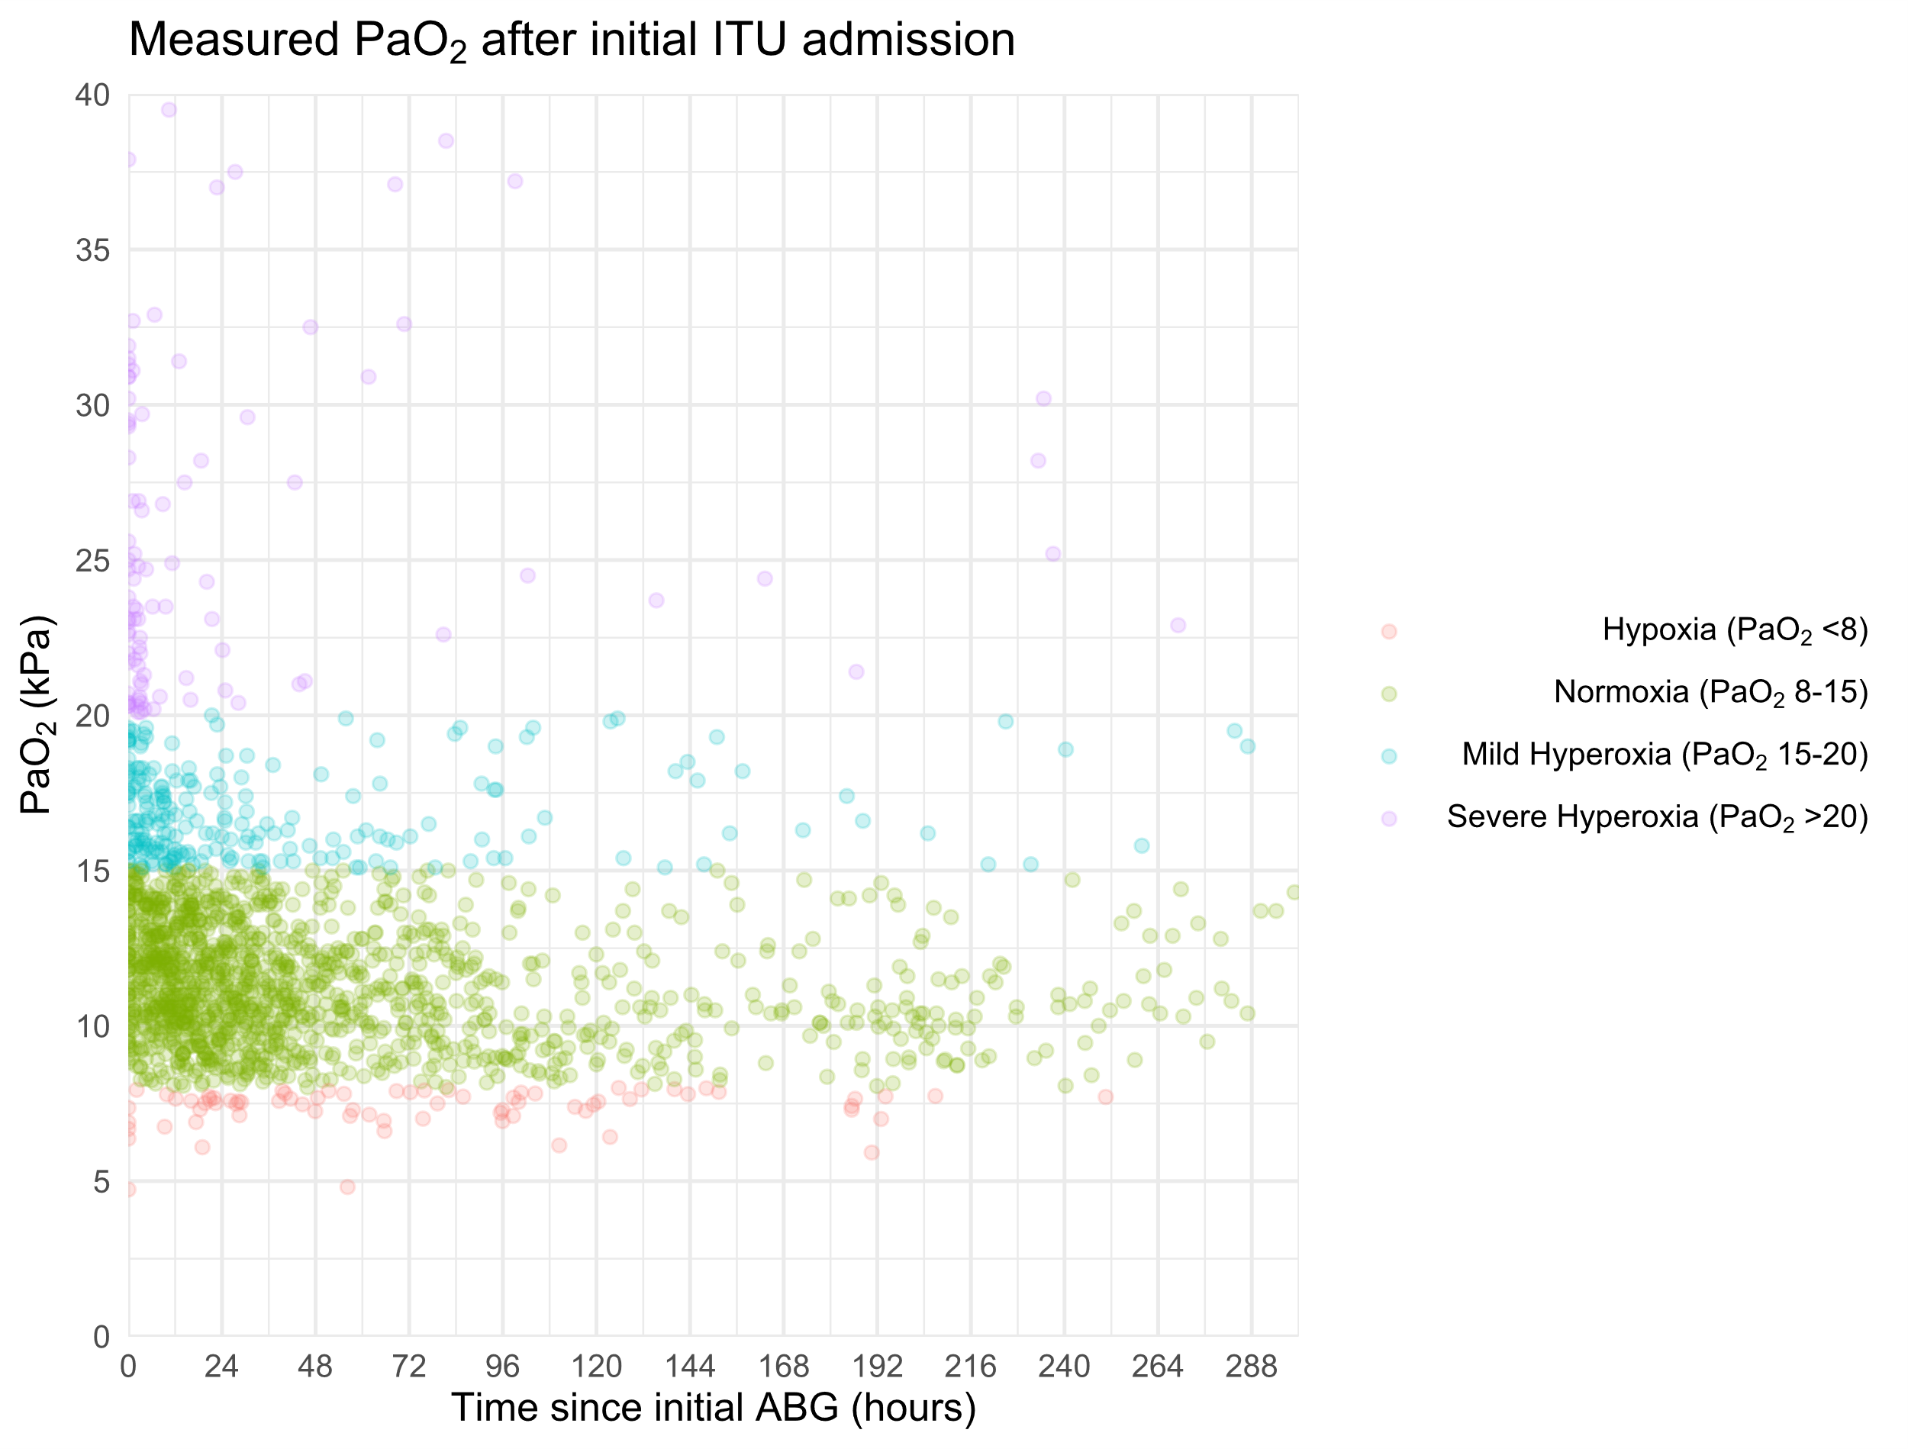

Slide 16
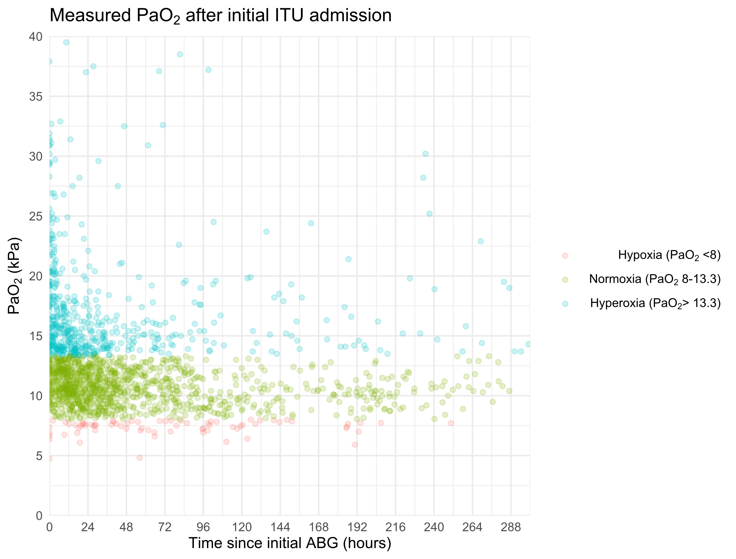

Slide 17

Take home messages..
Perioperative and ICU Hyperoxia associated with harm
Set a target – and review it
SpO₂ monitoring is adequate – not all need to be subjected to ABGs
Arguably Oxygen not needed unless SpO₂<90%
“Routine” targets 94-98%
“CO₂ retainer” target 88-92%

Slide 18
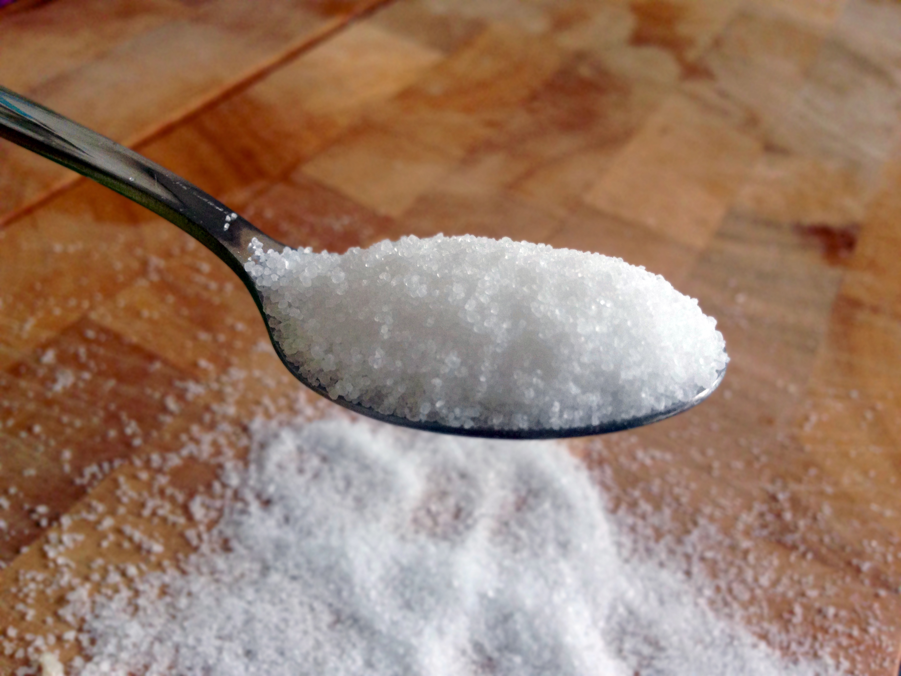

Slide 19


Slide 20

What we need is a
Randomised Controlled….
No!….

Slide 21

References
Slides
References

